Slide 1
Armory 102 – Charge Group Theory and Style Rules
Presented by
Yehuda ben Moshe
Elmet Herald

Slide 2
Charge Group Theory
SCA invention – SENA Appendix I
A charge group is a group of charges of approximately the same size and visual weight that act as a single visual unit
Most of our style and conflict rules are built around charge groups
“Core” style devices must be organizable into charge groups

Slide 3
Charge Group Theory
Primary Charge Group
  Always placed directly on the field
  Placed in the visual center of the field
  Usually the largest charge group
  Not all devices have a primary charge group
  A central ordinary is (almost) always the primary charge group

Slide 4

Charge Group Theory
Primary Charge Group
Bend

Slide 5

Charge Group Theory
Primary Charge Group
Two Bendlets

Slide 6

Charge Group Theory
Primary Charge Group
A lion

Slide 7

Charge Group Theory
Primary Charge Group
Three lions

Slide 8

Charge Group Theory
Primary Charge Group
Semy of lions

Slide 9

Charge Group Theory
Primary Charge Group
A cross

Slide 10
Charge Group Theory
Primary Charge Group
  On a divided field with no central charge, the charges on either side of the division are the primary charge group

Slide 11

Charge Group Theory
Primary Charge Group
A lion and a cross

Slide 12

Charge Group Theory
Primary Charge Group
A lion and semy of Crosses

Slide 13

Charge Group Theory
Primary Charge Group
Two crosses and an owl

Slide 14

Charge Group Theory
Primary Charge Group
An owl

Slide 15
Charge Group Theory
Primary Charge Group
  A peripheral ordinary (chief, base, bordure, canton, orle, etc.) can never be a primary charge
  Field-primary armory
    Armory with no primary charge group is considered to be Field-primary, and has special rules
    Two possible ways this can happen:
      No charges at all
      Peripheral ordinaries only

Slide 16
Charge Group Theory
Secondary Charge Group
  Always placed directly on the field
  Generally “surrounds” the primary charge group
  Cannot have a secondary without a primary group

Slide 17

Charge Group Theory
Secondary Charge Group
Primary: a chevron
Secondary: three roundels

Slide 18

Charge Group Theory
Secondary Charge Group – peripheral ordinary
Primary: a bend
Secondary: a bordure

Slide 19
Charge Group Theory
Secondary Charge Group – semy
Primary: a cross
Secondary: semy of lions

Slide 20
Charge Group Theory
Tertiary Charge Group
  Placed on another charge, not on the field
  A single charge may only have one tertiary charge group on it

Slide 21

Charge Group Theory
Tertiary Charge Group - Ok
Primary: a pale
Tertiary: three mullets

Slide 22

Charge Group Theory
Tertiary Charge Group - Ok
Primary: a pale
Tertiary: a tower between two mullets

Slide 23

Charge Group Theory
Tertiary Charge Group – No
Primary: a chevron
Tertiary 1: tower
Tertiary 2: mullet

Slide 24
Charge Group Theory
Overall Charge Group
  Crosses the center of the field
  Placed partially on the field and partially on other charges
  Underlying charge is the primary charge
  Can only have one overall charge group in any device
  In period, the overall charge is almost always a bend
  Overall charge must be substantially on the field

Slide 25

Charge Group Theory
Overall Charge Group - Ok
Primary: a lion
Overall: a bend

Slide 26

Charge Group Theory
Overall Charge Group – “barely” overall - No
Primary: a pale
Overall: a mullet
Notes:
Either: 1) Make the mullet much larger, to be a true overall, or 2) make it fit on the pale (and change tincture) and make it a tertiary.

Slide 27
Charge Group Theory
Maintained/Sustained charges
  “Held” by another charge, usually a primary
  Maintained charges are much smaller than the primary charge
    Considered artistic detail
    Do not count for difference
  Sustained charges are more than ½ of the visual weight of the primary charge, but less that the total visual weight
    Considered a secondary charge

Slide 28
Charge Group Theory
Maintained/Sustained charges
  Co-primary charge
    “Held” charge has equal visual weight to the primary charge
    Considered part of the primary charge group

Slide 29

Charge Group Theory
Maintained Charge
Primary: a dragon
Maintained: a sword

Slide 30

Charge Group Theory
Sustained Charge
Primary: a dragon
Sustained secondary: a sword

Slide 31
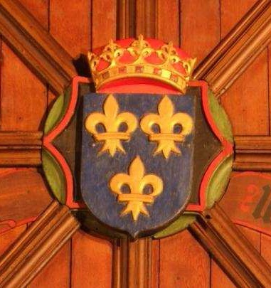
Rules of Heraldry – Blazon
Azure,
  three fleurs-de-lys
  Or.
Arms of France
Images from St. Machar’s Cathedral, Aberdeen, ca AD 1520
Notes:
No need to specify two-and-one – that’s the default for three.

Slide 32
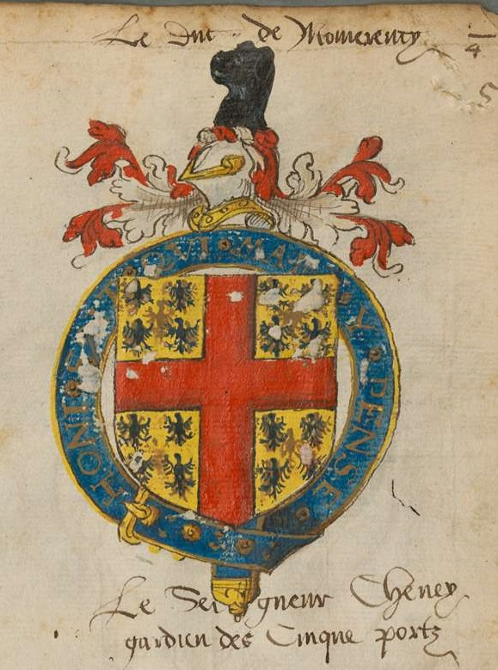
Rules of Heraldry – Blazon
Or
  semy of
  eagles azure,
  a cross gules.
Sir (Thomas) Cheney, Lord Warden of the Cinque Ports
Images from Insignia Anglica, mid 16C
Notes:
No need to say “throughout”, that’s default for crosses.
Semy is one of the few situations where central charge isn’t listed first.

Slide 33
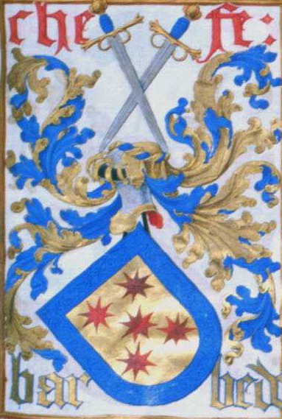
Rules of Heraldry – Blazon
Or,
  five mullets of eight points
  two, one, and two
  gules
  within a bordure
  azure.
Arms of the Chefe Barbedo (Portugal)

Slide 34
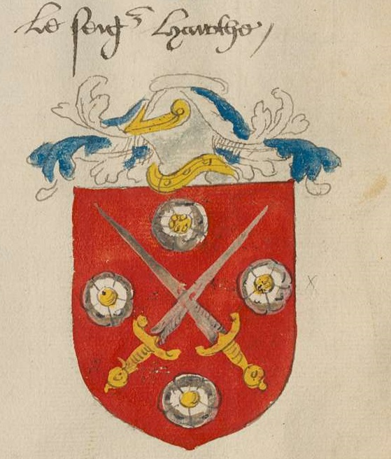
Rules of Heraldry – Blazon
Gules,
  two swords
  in saltire
  proper
  between four roses
  in cross
  argent.
Images from Insignia Anglica, mid 16C

Slide 35
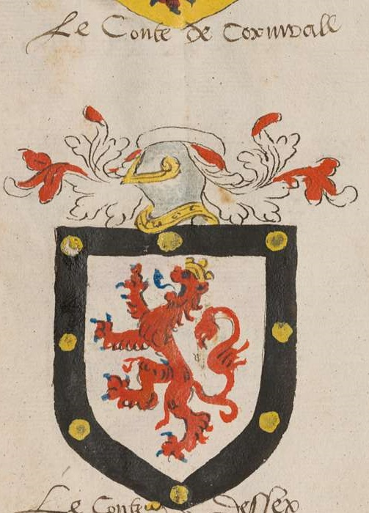
Rules of Heraldry – Blazon
Argent,
  a lion gules,
  a bordure
  sable
  semy of roundels
  Or.
Count of Cornwall
Images from Insignia Anglica, mid 16C
Notes:
Roundels Or can be called bezants.

Slide 36
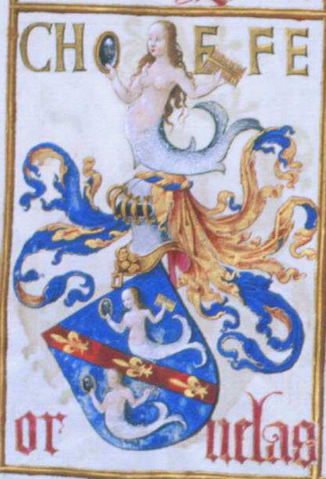
Rules of Heraldry – Blazon
Azure,
  on
  a bend gules
  between two mermaids argent,
  three fleurs-de-lys
  Or.
Arms of the Chefe Ornelas (Portugal)

Slide 37
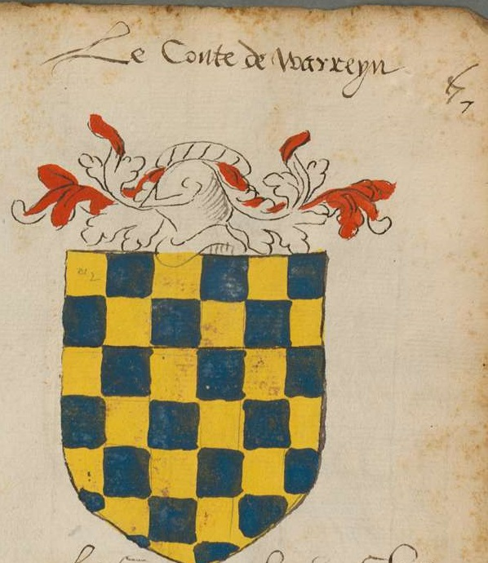
Rules of Heraldry – Blazon
Checky
  Or and azure.
Count of Warren
Images from Insignia Anglica, mid 16C
Notes:
Or is listed first since its in dexter chief, though no difference for conflict.
Semy is one of the few situations where central charge isn’t listed first.

Slide 38
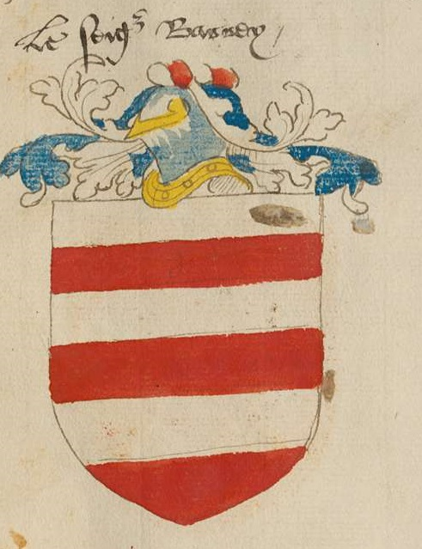
Rules of Heraldry – Blazon
Barry
  argent and gules.
Images from Insignia Anglica, mid 16C
Notes:
Even divisions, so barry. Argent to chief, so first.

Slide 39
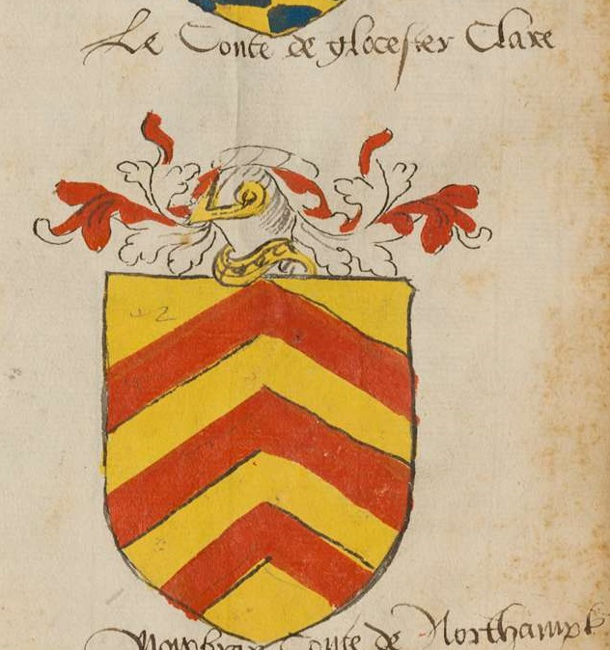
Rules of Heraldry – Blazon
Or,
  three chevronels
  Gules.
Count of Clare
Images from Insignia Anglica, mid 16C
Notes:
Not chevronelly since unequal number of parts

Slide 40
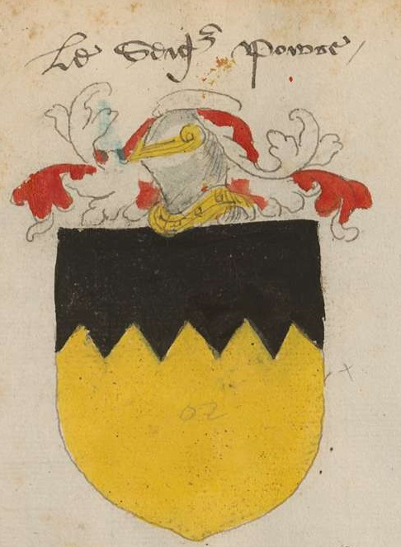
Rules of Heraldry – Blazon
Or,
  a chief indented
  sable.
Images from Insignia Anglica, mid 16C

Slide 41
Armory Rules – Types of Armory
Individual submitters are allowed six pieces of armory
  Device
  Badges
SCA Branches may register any number of pieces of armory
  Device
  Badges

Slide 42
Armory Rules – Types of Armory
Device
  One device per submitter
  Becomes “Arms” when granted an AoA
  Identifies “This is me”
  Submitted on a shield-shaped form

Slide 43
Armory Rules – Types of Armory
Badge
  Multiple badges permitted
  A badge can be an alternate device
  A badge is used to identify “This is mine”
    Possessions
    Household members
    Retinue
  Can have a field or be fieldless
  Submitted on a square-shaped form

Slide 44
Armory Rules – Types of Armory
Armory with a field (A3A1)
  Field is specified – solid tincture or partitioned
Fieldless badges (A3A2)
  Do not have a defined field
  Can be displayed on any background
  All charges must touch one another
    “Cast out of metal” rule

Slide 45
Armory Rules – Contrast
Rule of Tinctures (A3B)
  Don’t place a metal on a metal or a color on a color
Good Contrast
  Metal and color
  Metal and neutral
  Color and neutral

Slide 46




Armory Rules – Contrast
Good contrast is required when a charge is placed on a background (A3B4)
  Identifiability must be maintained
Good Contrast
Poor Contrast

Slide 47
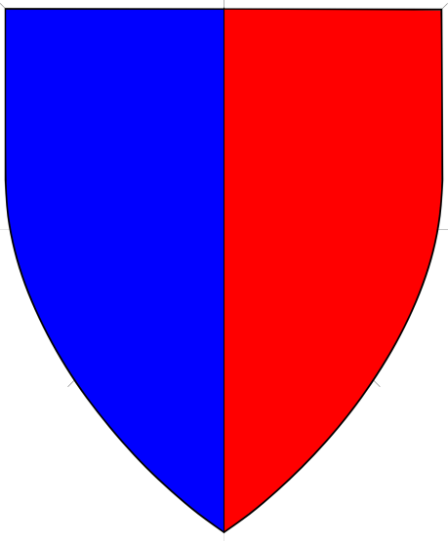

Armory Rules – Contrast
Divided fields (and charges) (A3B3)
  Fields divided into two parts
    Don’t need good contrast
    Can’t have the same base tincture
Ok
No

Slide 48


Armory Rules – Contrast
Divided fields (and charges) (A3B3)
  Fields divided into three parts (per pall)
    Need good contrast between one part and the other two
    No two parts can share the same tincture or base tincture
Ok
No

Slide 49
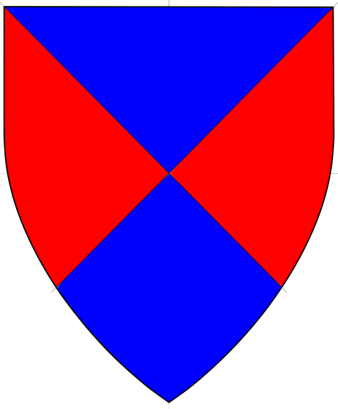
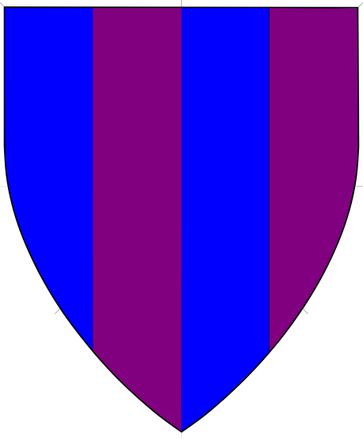
Armory Rules – Contrast
Divided fields (and charges) (A3B3)
  Fields divided quarterly or per saltire
    Don’t need good contrast
    Can’t have the same base tincture
  All other field divisions must have good contrast
Ok
No

Slide 50



Armory Rules – Charge Groups
Clarity of charge group (A3D1)
  Charges must be clearly organized into charge group
  Blurring the distinction between charge groups is not permitted
No
Ok
Notes:
Ignore the lack of contrast….

Slide 51


Armory Rules – Charge Groups
Slot Machine (A3D2a)
  A charge group may not contain more than two types of charges
  Posture, tincture, etc. don’t count
No
Ok
Notes:
Why is the image on the right Ok? Charge group theory! Primary is pale, secondary is estoile and heron, tertiary is chalice.

Slide 52


Armory Rules – Charge Groups
Unity of Posture (A3D2c)
  Charges in a charge group must be either
    In identical postures/orientations, or
    In a period arrangement which includes posture/orientation
  Crescents are an exception
No
No

Slide 53
Disallowed Elements
Restricted Charges (A6B1, GoT Table 3)
  Charges which may not be used by anyone
  Examples:
    Red Cross/Crescent (Symbol of the IRC)
    Crowned Rose (Symbol of England)
    Swastika/fylfot (Offensive)
    Etc.

Slide 54
Disallowed Elements
Reserved Charges (A6B2, GoT Table 2)
  Charges which may only be used by certain submitters
  Examples:
    White belt (Reserved for Knights)
    Laurel wreath (Reserved for Society Branches)
    Chaplet of roses (Reserved for Princesses)
    Etc.

Slide 55
Disallowed Elements
Unregisterable Charges (A2B5)
  Charges which may not be registered as they are not period
  Generally set by precedent
  Examples:
    Garden Rosebud
    Ribbon
    Selkie
    Etc.

Slide 56
Disallowed Elements
Step from Period Practice (SFPP) (A2B4, Appendix G)
  One SFPP is permitted in a device, two or more are grounds for return
  Non-European Armorial Elements
    Islamic
    Japanese
    May require an IAP

Slide 57
Disallowed Elements
Step from Period Practice (SFPP) (A2B4, Appendix G)
  Non-European Plants and Animals
    Except those used in period heraldry
    Must be from a part of the world known to period Europeans
      Interiors of Africa, North America not allowed
      Northern Asia and Australia not allowed
      Gray period is of limited use
  Other charges and motifs listed in Appendix G or by precedent

Slide 58
Presumption
Restricted or Reserved Charges (A6B)
  Use of a restricted charge is prohibited as presumptive or offensive
  Use of an un-earned reserved charge is prohibited as presumptive

Slide 59




Presumption
Arms of Pretense or Augmentation (A6C)
  A single charged escutcheon or charged canton may only be used by a submitter who has been granted an Augmentation of Arms (Augmentation of Honor)
No
Ok

Slide 60
Presumption
Marshalling (A6F)
  Marshalling is the combination of two or more arms into a single design
  Not registerable in the SCA
  We are assumed to each earn our own arms

Slide 61


Presumption
Marshalling (A6F)
  Only occurs on a Per Pale field (dimidiation or impaling) or a Quarterly field
  Only occurs with a plain line of division
No
Ok

Slide 62


Presumption
Marshalling (SENA A6F)
  A single primary charge group over the whole field removes the appearance of marshalling
Ok
Ok
Notes:
Another way is adding a chief

Slide 63
Presumption
Combination of Name and Device (A6D)
  Even if a name and device are independently acceptable, a combination of the two may be presumptuous
  Examples
    “York” and a white rose
    “Lancaster” and a red rose

Slide 64
Final Thoughts
Registerable vs. Authentic
  A submission must be registerable; it need not be authentic
  While we can encourage clients to design period-looking armory, we cannot, and should not, force the decision
  If a client is set on a registerable but not very authentic submission, you should process it!

Slide 65
Final Thoughts
Customer Service
  It is our job to help our clients
  We are here to make registrations happen, not prevent them from happening
  When consulting, help clients create registerable submissions they like
  When commenting, look for reasons to allow registration, not prohibit it
  Heralds want a reputation for being helpful, not obstructionist!

Slide 66
About me
Elmet Herald – I am the East Kingdom heraldic education deputy
elmet@eastkingdom.org
jgalak@gmail.com
This handout can be found at:
  http://www.yehudaheraldry.com/ekhu

